Slide 1
Industrial goods loading system
Tarun Thathvik | Vedant Desai | Smrithi Thudi

Slide 2
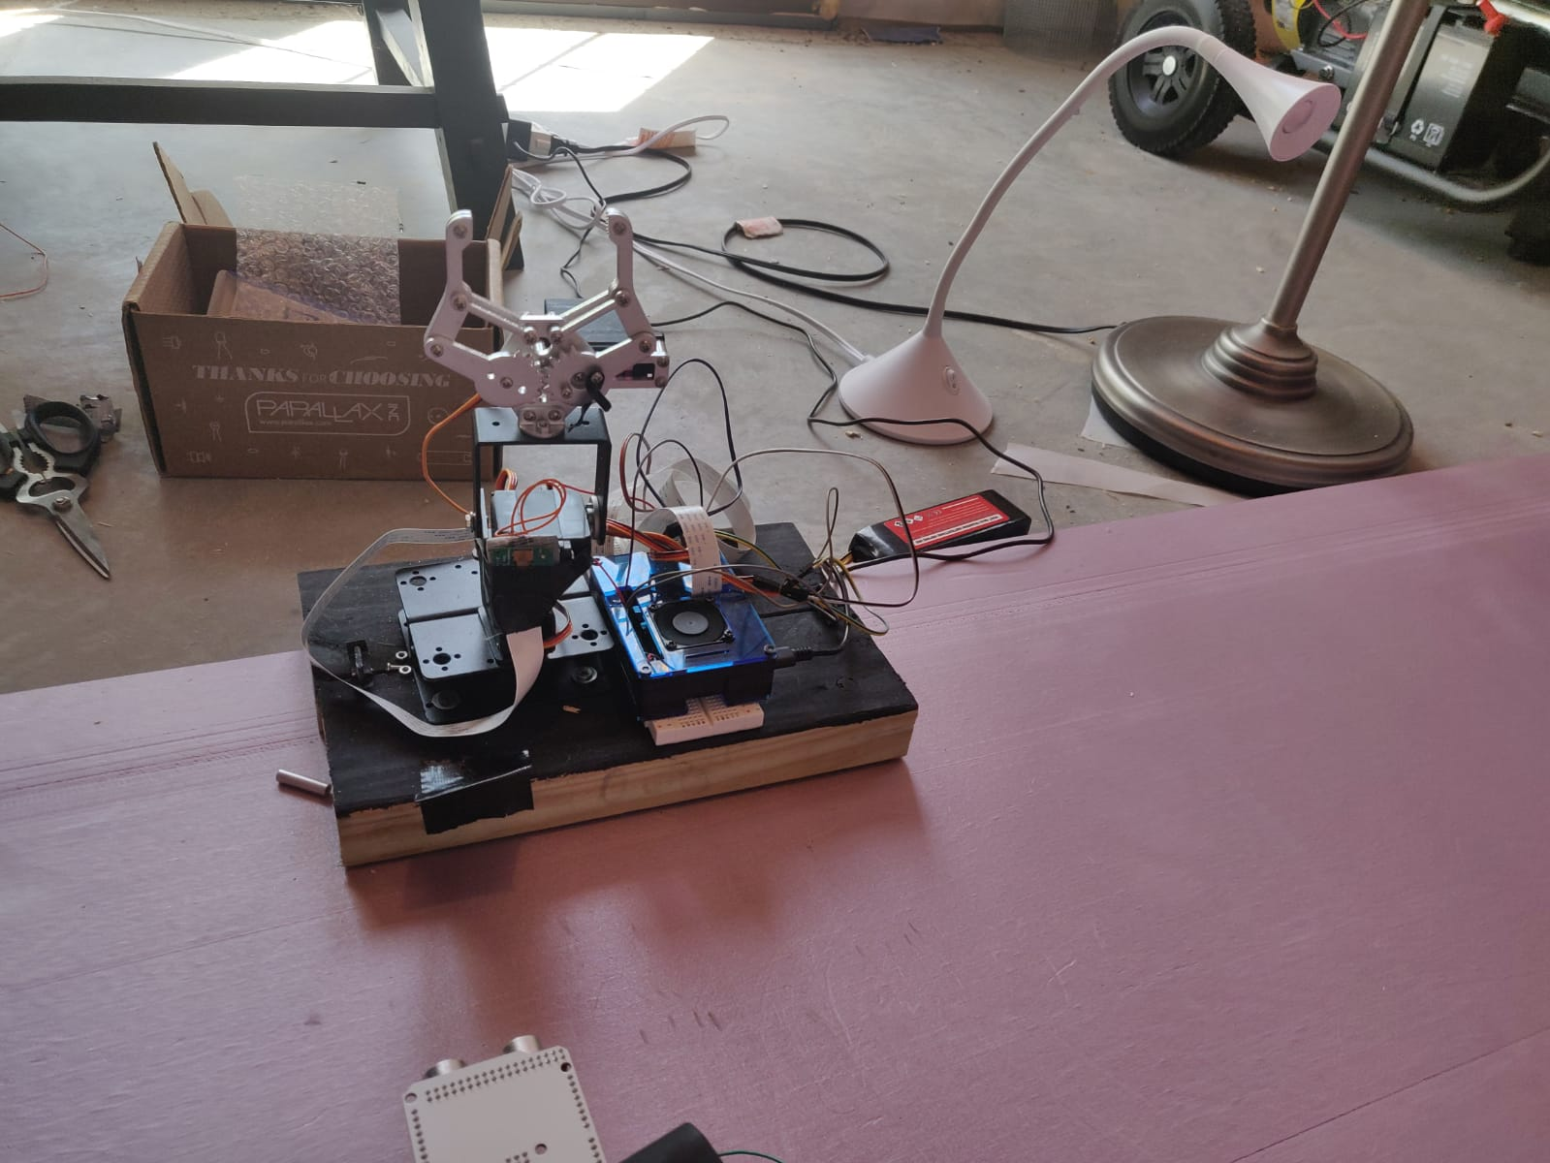
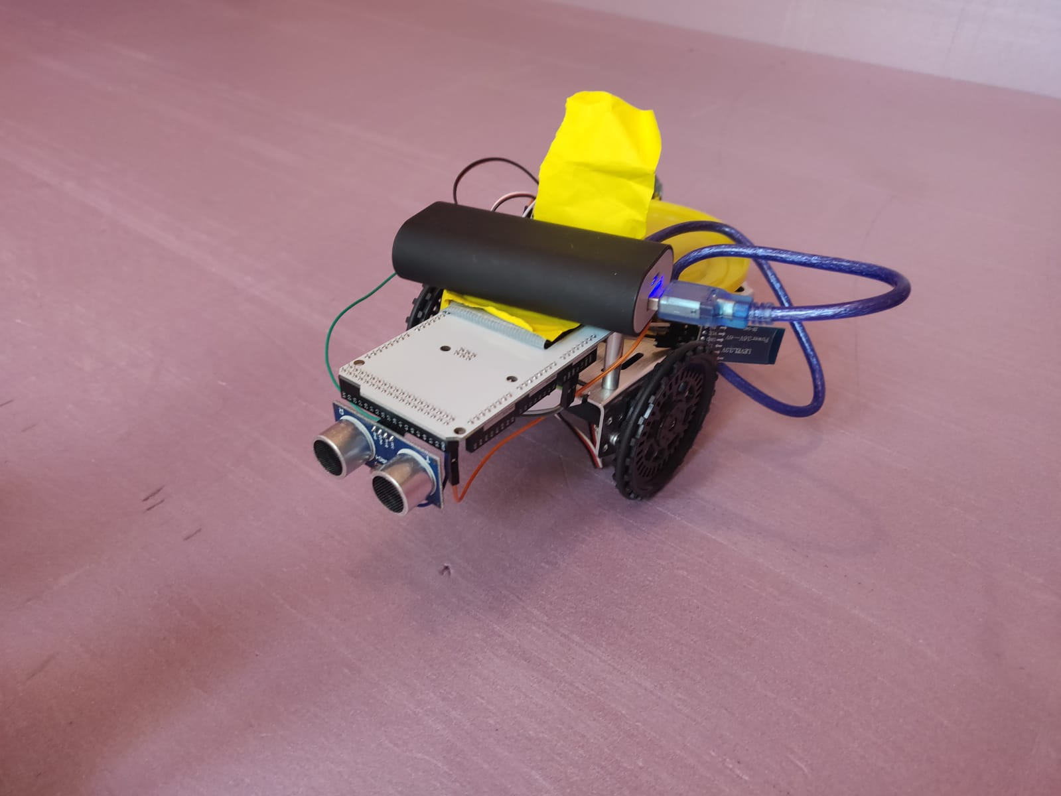
Robotic arm
Transportation Bot

Slide 3
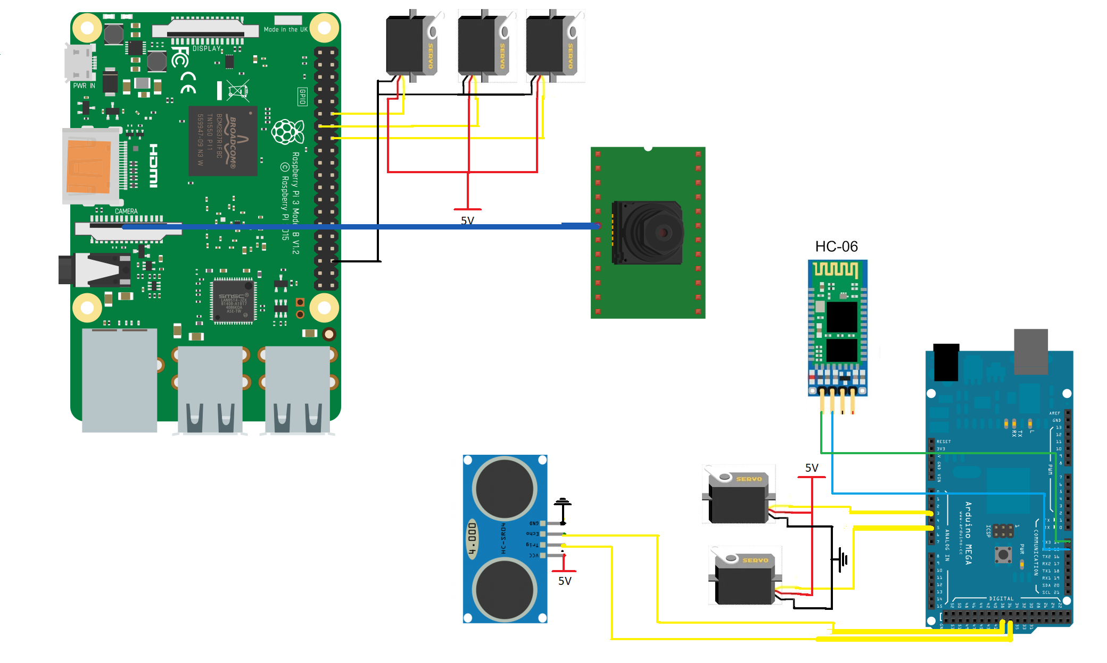
Circuit Diagram
Rpi has only 2 pwm pins
We used 3 servos - wrote our own pwm code

Slide 4
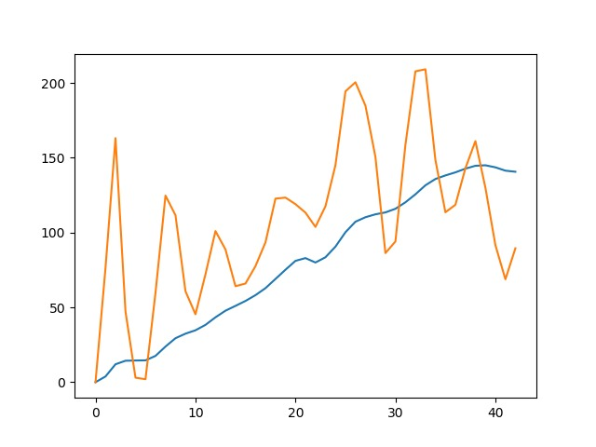
Low pass filter
fs = 300
fc = 1
w = fc / (fs / 2)
b, a = signal.butter(5, w, 'low')
output = signal.filtfilt(b, a, xn)
x = np.average(xn[490:500])
plt.plot(xm, label='x')
plt.show()

Slide 5
Thank you

